Slide 1
Business Analytics
Linear Regression & Logistic Regression
Priyanka Shrivastava, PhD
St. Mary’s college of California

Slide 2
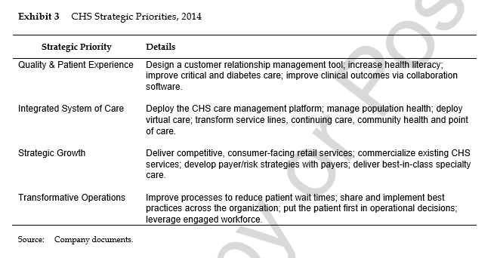

Slide 3
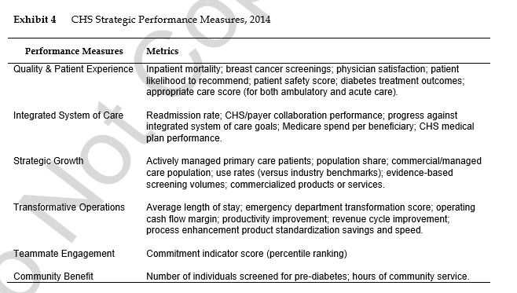

Slide 4
Agenda
Introduction
Basics of Logistic Regression
Logistic Regression conceptual understanding
Business Use Cases
4

Slide 5
First time Home Buyer : Practical Case
As a first time home buyer Jacob is busy organizing your financial records to apply for a home mortgage. Lenders will factor in your credit score to approve or not approve his mortgage. Turns out that his credit score is 720.
Financial Analyst who is reviewing Jacob’s mortgage application has been tasked by the company to develop a model to highlight the probability of getting a mortgage approved for a given credit score. He has been provided with data of 100 customers with their credit scores and details whether the home mortgage was approved or not.
Notes:
Jacob is busy researching that his mortgage will be approved or not. He gets a raw data of 100 customers with their credit scores and details whether the home mortgage was approved or not.

Slide 6
Using the data Jacob wants to do following tasks
Develop a model to understand the probability of getting a mortgage approved for a given credit score
Input his credit score of 720 and see the probability of getting his mortgage approved
Understand the effect to improving credit score from 720 to 750 on his chances of mortgage being approved
6

Slide 7
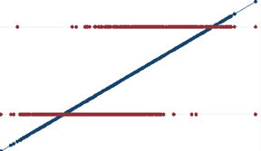
Looking at the Scatter plot how do we plot the best fitting line and will linear regression help?
Mortgage approval Status
Credit Score
Logistic Regression models the probability of an event ,which is binomial in nature, based on independent variables which are categorical or numerical

Slide 8
Logistic Regression: Deep dive
Odds = P (Occurring) / P (Not Occurring)
Odds Ratio = Odd₁ / Odd₂
The dependent variable in Logistic regression follows Bernoulli's distribution having an unknown probability, p
Probability of success is p, then probability of failure, q = 1-p
In Logistics regression we are estimating unknown probability, p for any given combination of the independent variables
Therefore we need to link together our independent variables to essentially Bernoulli’s distribution, that link is called “Logit Function”, which log of odds
Logit (p)= ln (odds) = ln (p/1-p)= ln (p) – In(1-p)
8

Slide 9
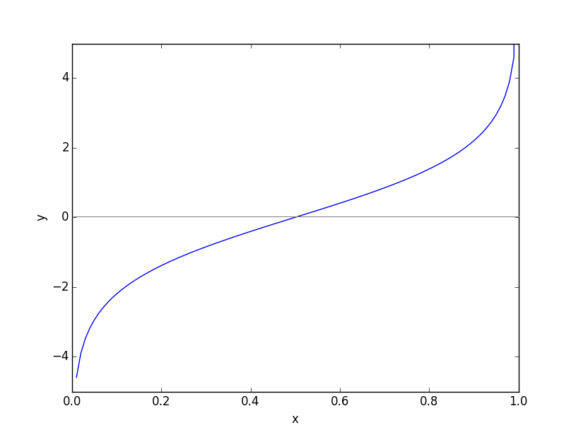
Logit Function
Logit p = ln (p/1-p)

Slide 10
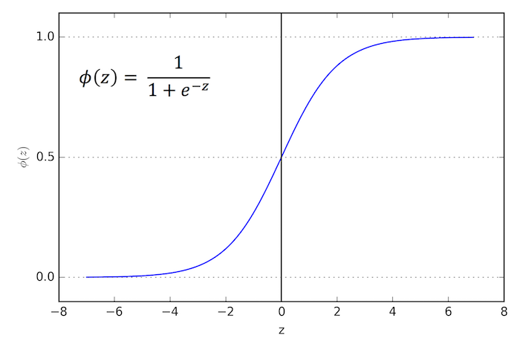
What is inverse Logit?
In our logit function graph, 0 and 1 ran on x-axis, but we want 0 and 1 on the y-axis. We can get that by taking inverse of logit function.
Mortgage approval Status
Credit Score

Slide 11
Estimated Regression Equation
The natural logarithm of odds function (logit function) is equivalent to linear function of the independent variable. The antilog of logit function allows us to find out estimated regression equation.
Logit (p) = ln(p/1-p) = b_{o} + b₁ x
Antilog= p/1-p = e ^{bo + b1 x}
p = e ^{bo + b1 x} / 1 + e ^{bo + b1 x}

Slide 12
Logistic Regression
Classification Table
Observed Predicted
Approval Percentage Correct
0 1
Step 1 Approval 0 37 6 86.0
1 3 54 94.7
Overall Percentage 91.0
a. The cut value is .500
Variables in the Equation
B S.E. Wald df Sig. Exp(B) p-value
Step 1ª Credit score 0.036 .008 18.847 1 .000 1.037
Constant -22.525 5.357 17.681 1 .000 .000
a. Variable(s) entered on step 1: Credit score.
Estimated Regression Equation: p = e ^{-22.525 + .036 x} / 1 + e ^{-22.525 + .036 x}

Slide 13
Results from the analysis
Estimated Regression Equation: p = e ^{-22.525 + .036 x} / 1 + e ^{-22.525 + .036 x}
Credit Score | p-value | (1-p) value | Odds
720 | 0.96754 | 0.032 | 30.235
750 | 0.9887 | 0.011 | 89.88
Odds Ratio: 89.88/30.235 = 2.972
Probability of Jacob getting the loan is .9675 or 96.75 %
Odds Ratio signifies → Improving credit score from 720 to 750 improves Jacob’s chances of loan approval by 197 %.

Slide 14
Business Use Cases
Predictive Analytics….Forecasting future opportunities and risks
Operation Efficiency….To optimize business processes
Consumer insights….Predict consumer behavior based on marketing initiatives

Slide 15
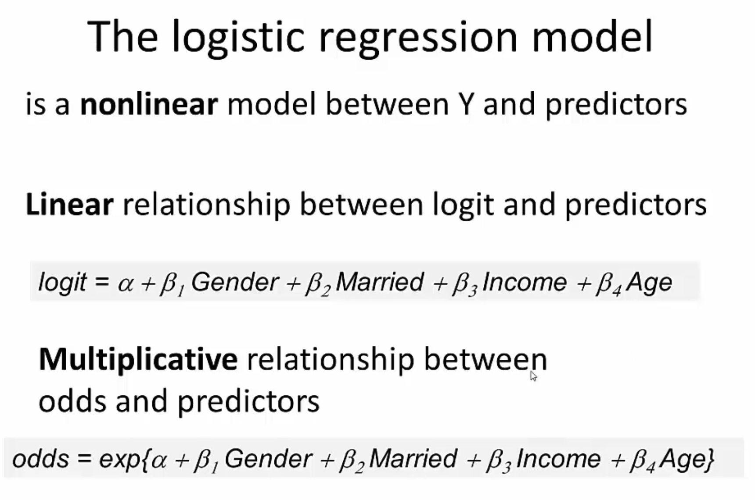

Slide 16
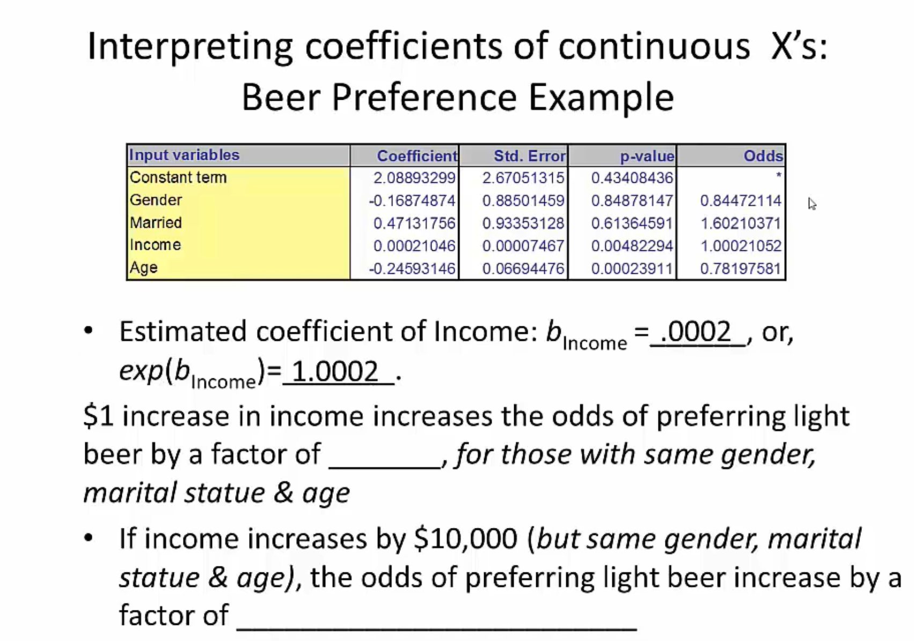

Slide 17
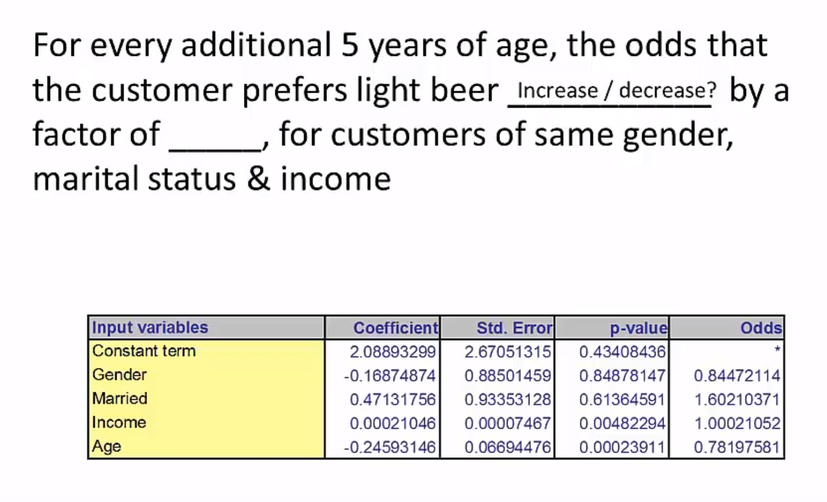

Slide 18
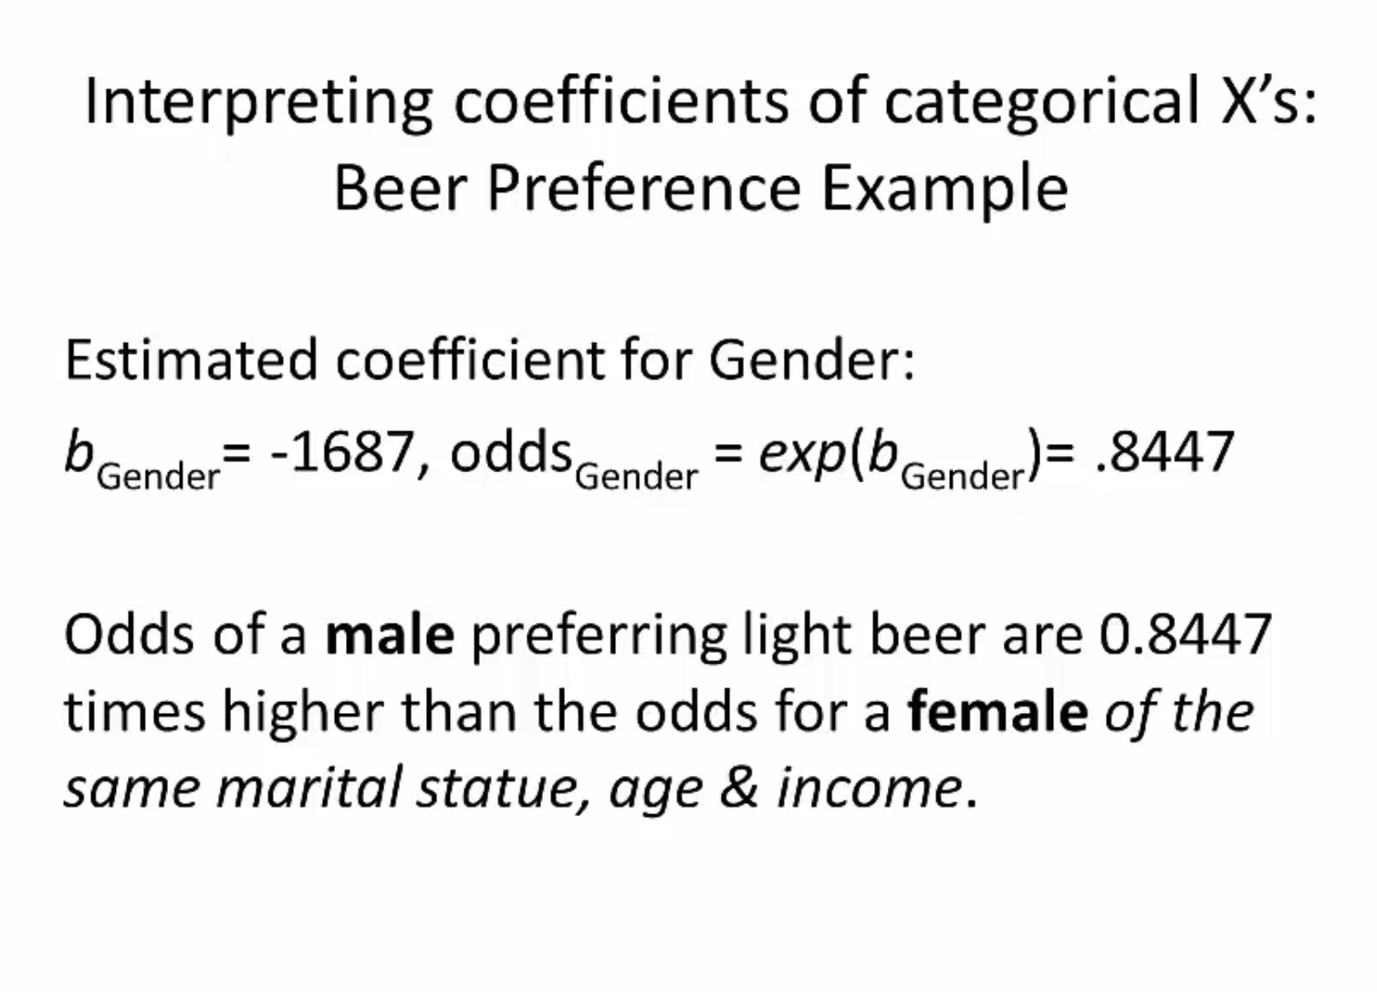

Slide 19
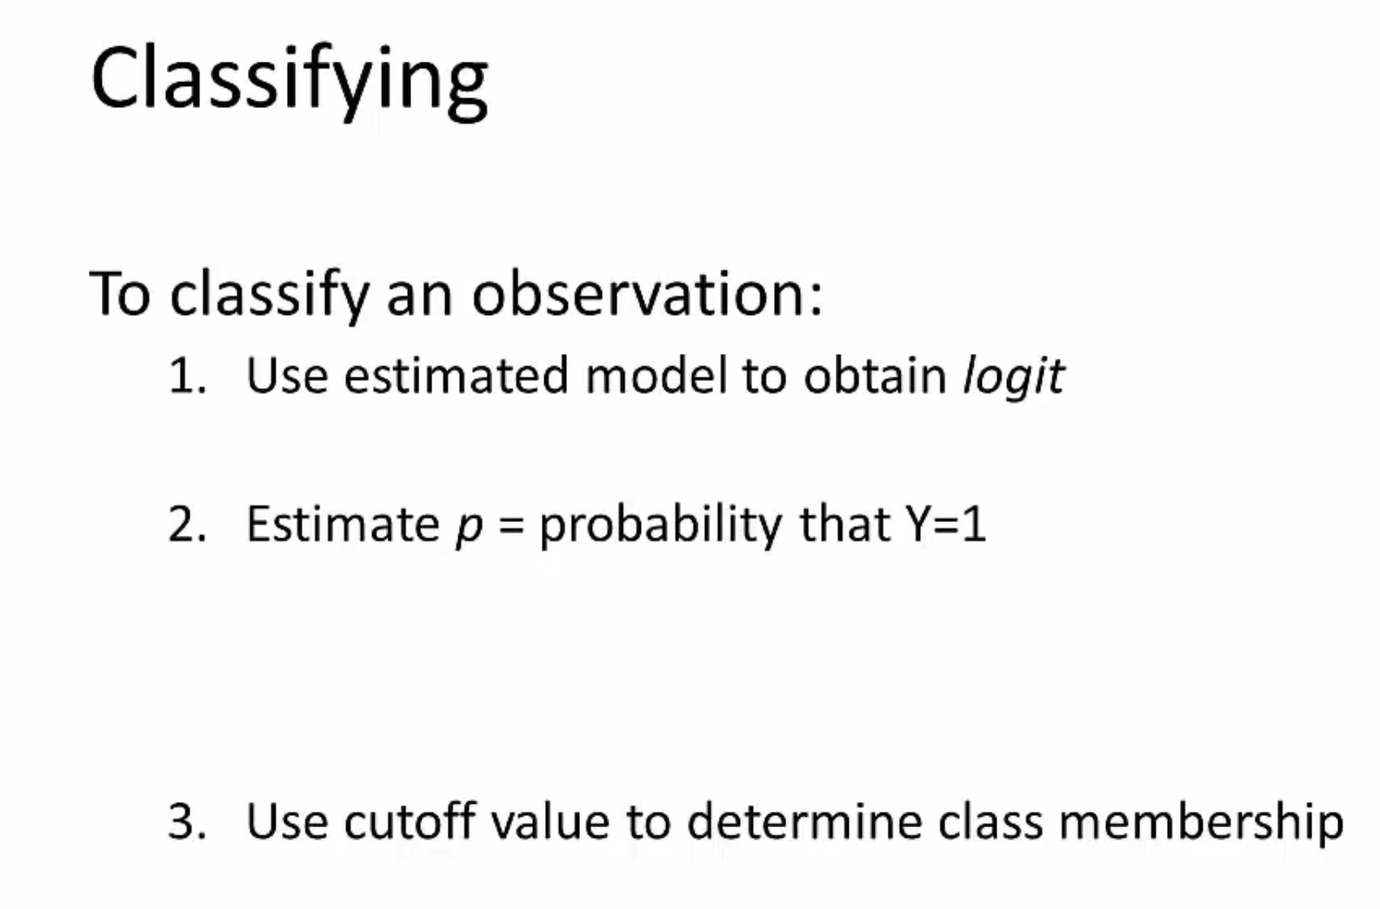

Slide 20
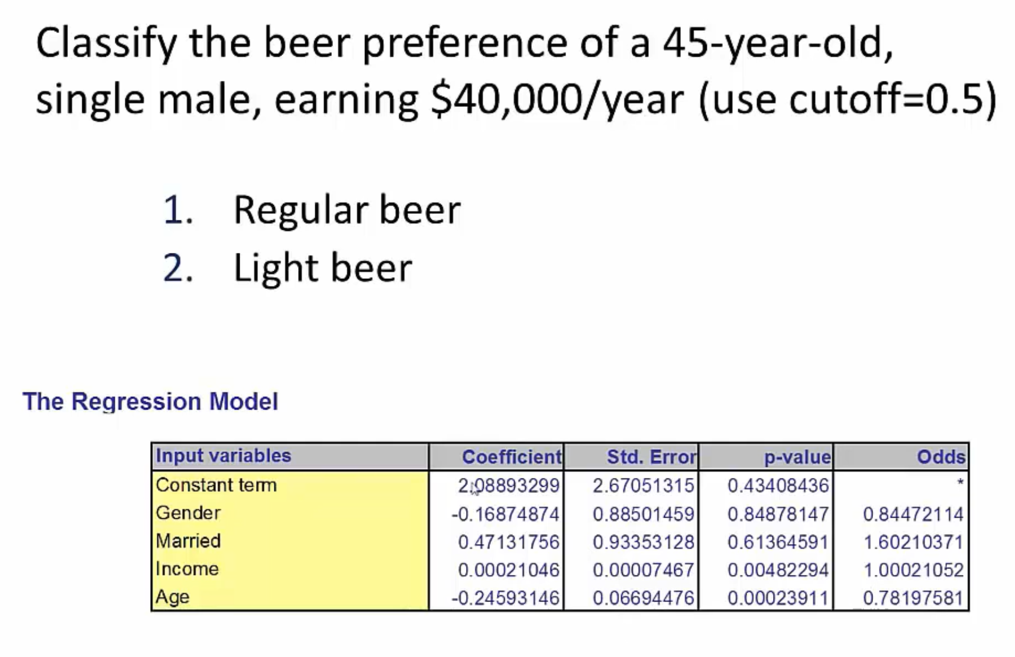

Slide 21
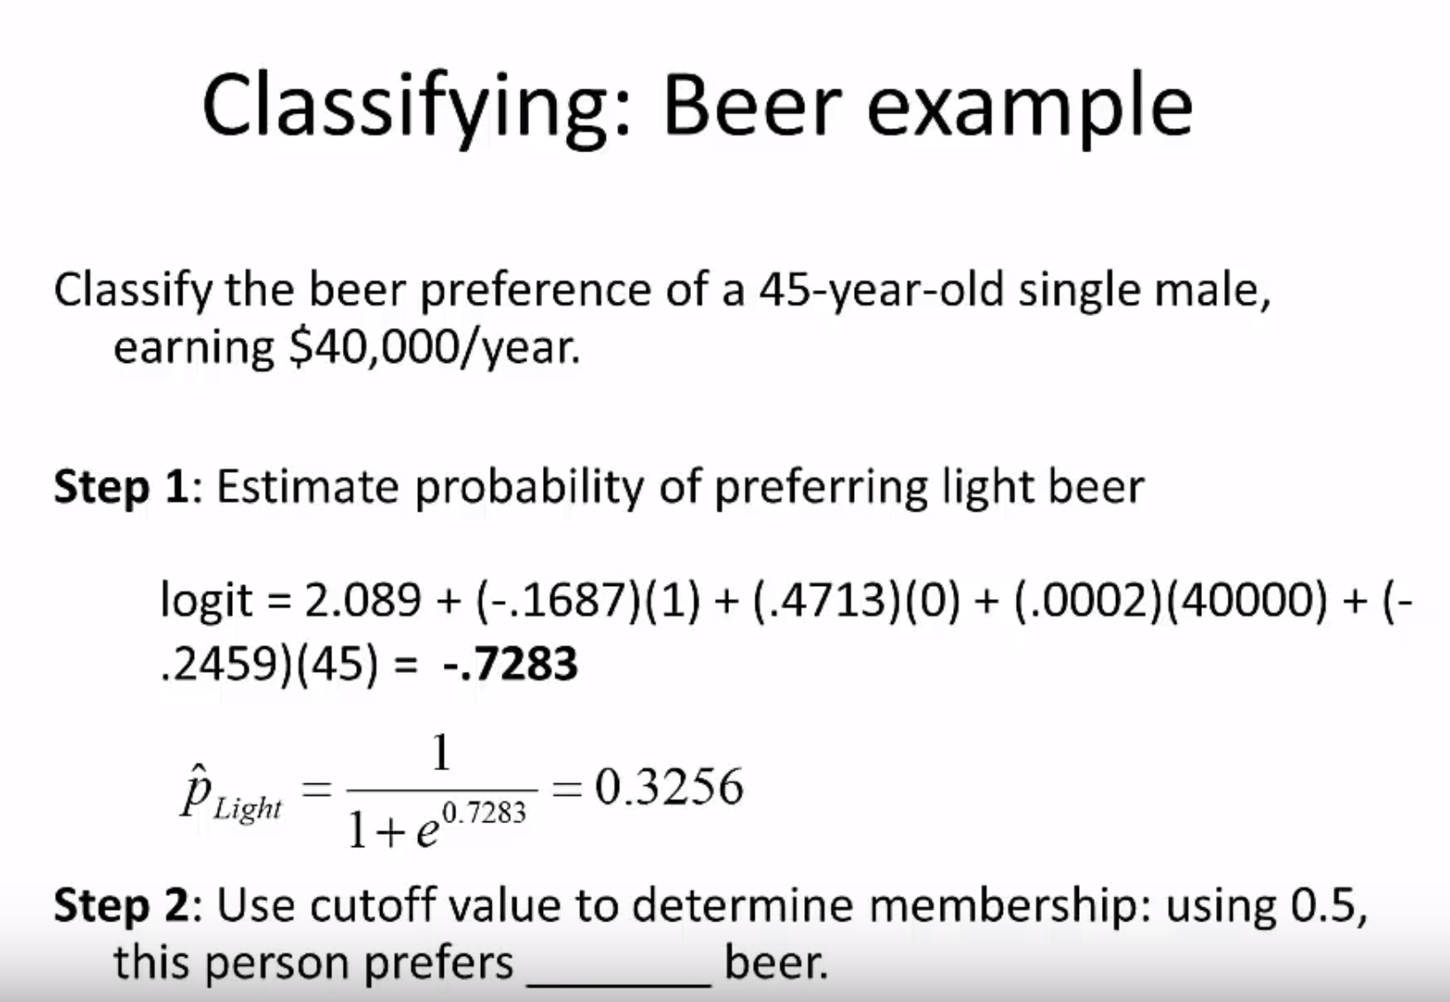

Slide 22
Thank You !
“Analysis * Story = Value”

